Slide 1
LocateMyView An application to estimate the exact location of images using their visual features
Ali Zafarani
ali.zafarani@gmail.com

Slide 2
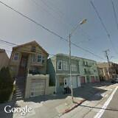
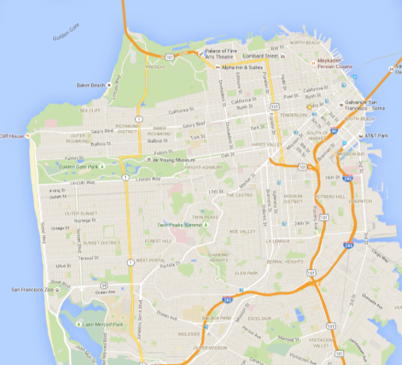
Problem
Can we create a model using street view images to predict the location of the photo?
???

Slide 3
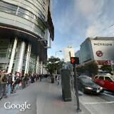
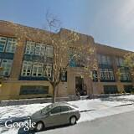
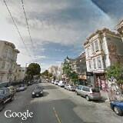
Motives
Geo-location & image featurization
Business Marketing, real estate, insurance, news and media, etc.
Emerging applications of deep learning.
Notes:
Large information is hidden as images and videos in social media, challenging to analyze due to size and unstructured format of the data.
Deep learning is
Breaking news detection
In social media, breaking news are often detectable faster with images rather than text

Slide 4

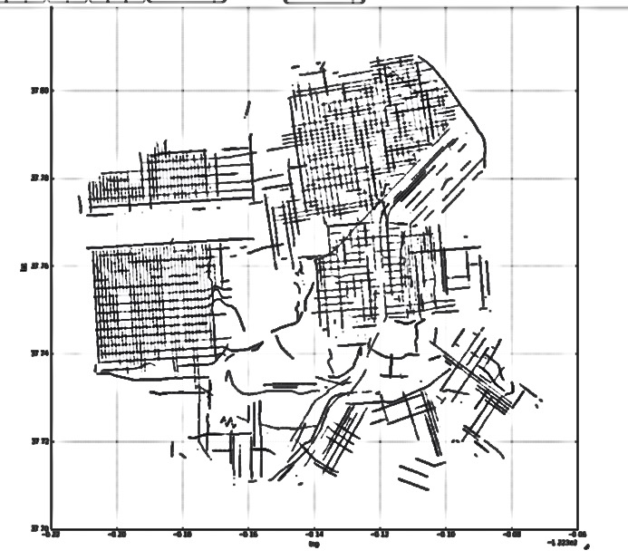
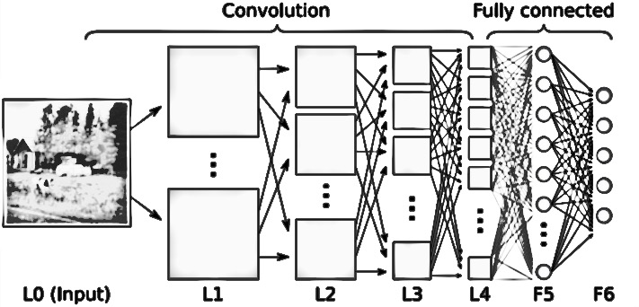
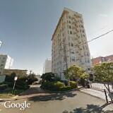
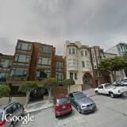
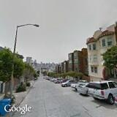
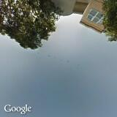
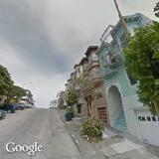
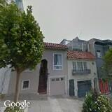


Data Pipeline
Street, intersections and business database

Slide 5
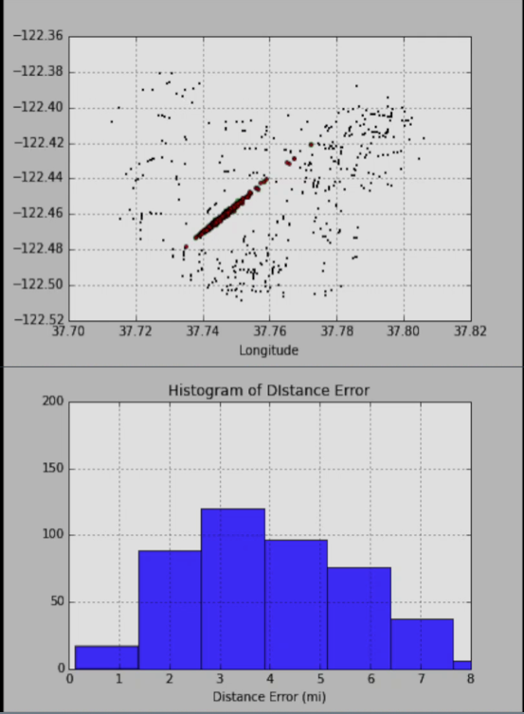
Test Results
Top video shows test points converge to true values. Points become green when they reach 1km of true value.
Bottom video shows the distance error in miles shrinking as model is fit.
2 mi
Notes:
Title to results
Label axes
Prediction error
Histogram

Slide 6
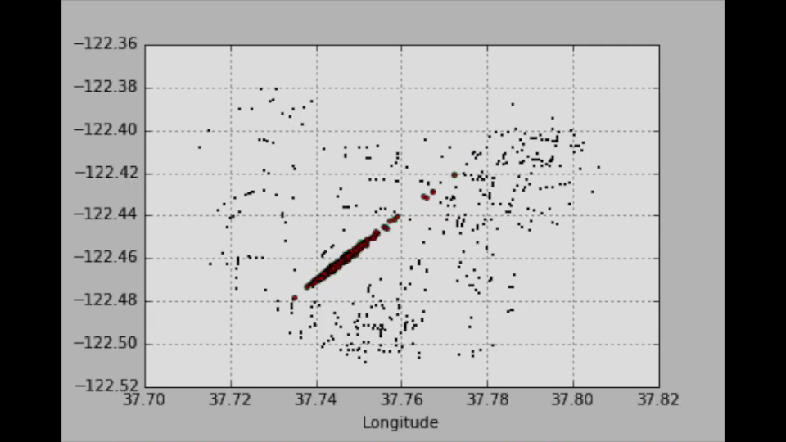
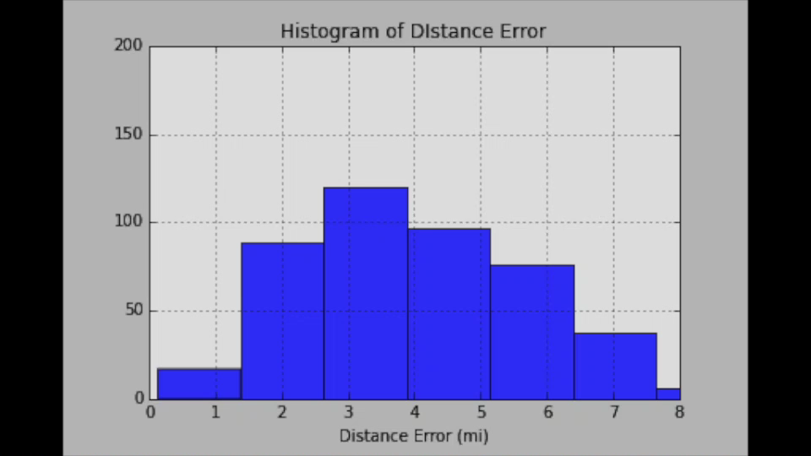
Test Results
Test points converge to true values as model is getting trained. Points become green when they reach 1km of true value.
The distance error in miles shrinking as model is fit.
2 mi

Slide 7
Other Learnings
Geo-locating images is feasible.
Continuity of training set is important.
Model performance is highly sensitive to CNN parameters.
Computational demands increase rapidly with area.
Notes:
Title to results
Label axes
Prediction error
Histogram

Slide 8
Next steps
Develop web application to geo-locate user input photo
Extend model coverage to all areas of San Francisco
Current model covers about 1/3 of the streets
Extend the model to other cities and areas.

Slide 9
Thank you!
Ali Zafarani
ali.zafarani@gmail.com

